Slide 1
Person-centred care in 2017
@NVTweeting
#personcentred
www.nationalvoices.org.uk

Slide 2
Five domains of person-centred care
Information
Communication
Involvement in decisions
Care Coordination
Care planning

Slide 3
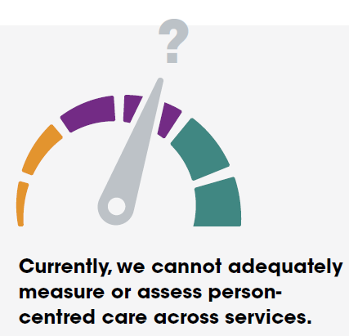
Conclusions
Person-centred care is inadequately measured.

Slide 4
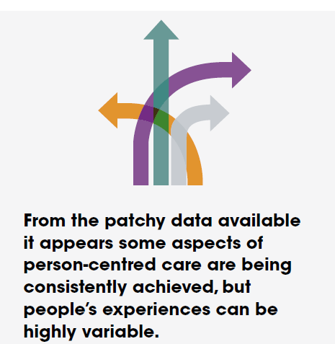
Conclusions
A mixed picture: people’s experiences can be highly variable.

Slide 5
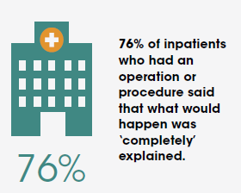
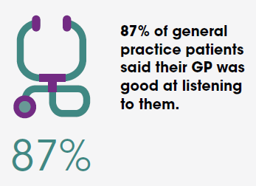
Conclusions
Some aspects of person-centred care have improved

Slide 6
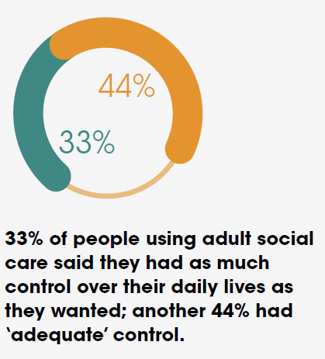
Conclusions
Progress towards
involvement in decisions and
being in control.

Slide 7
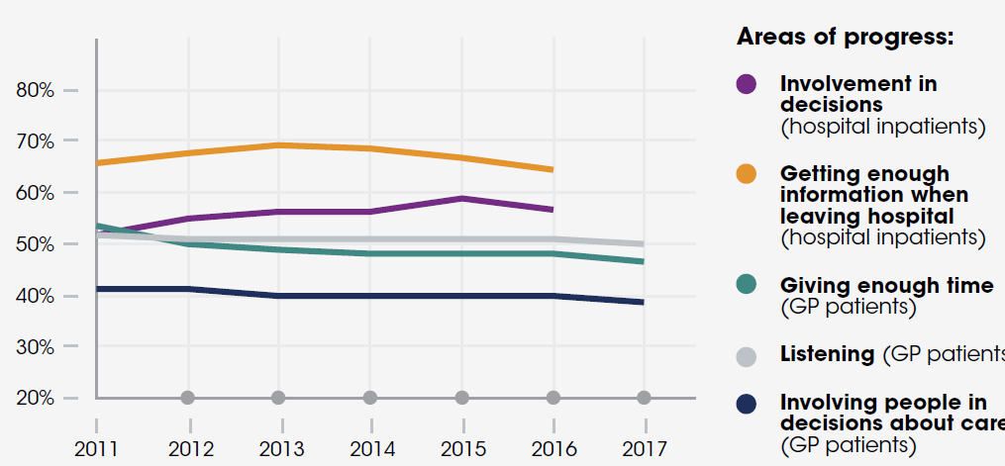
Conclusions
Steady progress is now deteriorating

Slide 8
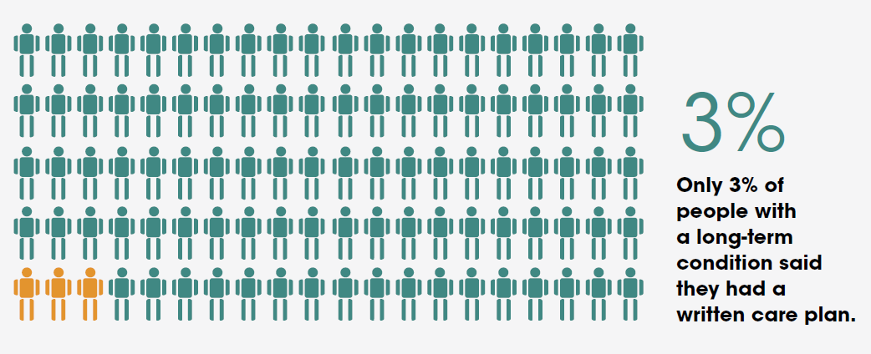
Conclusions
Little evidence of personalised care and support planning

Slide 9
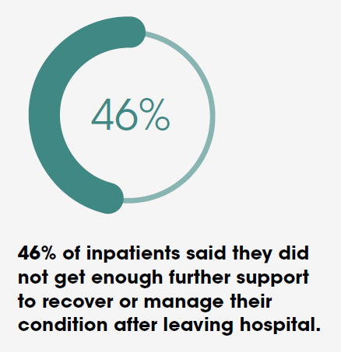
Conclusions
Coordination
of care is not
measured.
The best indicators we have show poor results.

Slide 10
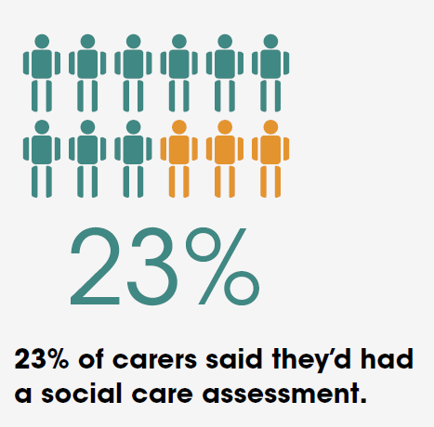
Conclusions
Family involvement is not central, and most carers need better support.

Slide 11
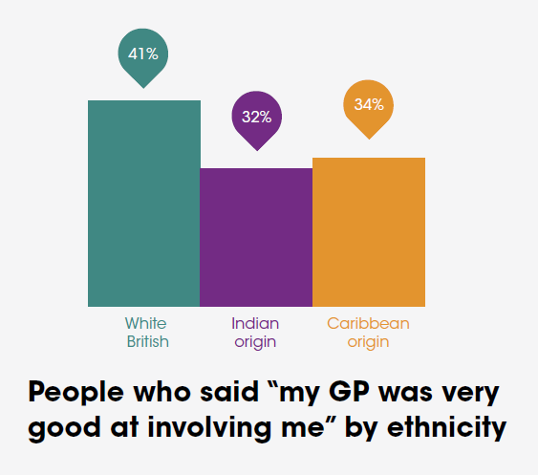
Conclusions
Some indicators of inequality.

Slide 12
Implications
Mainstream person-centred care
See the high impact actions suggested by the People and Communities Board, January 2017.
A strategic overhaul of measurement
Vital to plug the quality gap and to help go-ahead local systems to succeed. Review and overhaul measures across health and social care, focusing on common system outcomes that matter to people.

Slide 13
Questions?
#personcentred

